Slide 1
Introduction to Optimization
MGMT 6550
CSUB

Slide 2
Decision-making with continuous variables
New topic- discrete search (donvex) optimization
Linear programming we work with was developed as part of Business Operations Research- Examples
  Cracking crude oil into useful components- gasoline, kerosene, JP-4, plastics
  Determine NFL schedule to minimize travel/time costs- with constraints. Each team within a division must play against each other team in the same division twice: once at home, once away
  Schedule non-division games against opponents of approximately the same strength
 | Discrete | Continuous
Solution space: | Fixed number of possible outcomes - choose the best among a finite number of alternatives Linear Programing | Infinite number of possible responses; find the best Optimization using non-linear estimation

Slide 3
Micro Econ example: manufacturing furniture
A factory makes tables and chairs.
Each table returns a profit of $100 and each chair a profit of $50.
Weekly availability of resources/manufacturing requirements:
  6K hours of labor available, and 9K units of wood.
  Each table requires 2 hours of labor and 3 units of wood
  Each chair requires 1 hour of labor and 1 unit of wood.
The factory PROBLEM: How many tables and chairs should the factory make to maximize profit?
What if a further constraint that 4 chairs must be made for each table, then how many of each must be made?

Slide 4
Graphical set up
This problem is easy to see if we graph the simple case; we’ll solve the more difficult case using R studio.
In equation form: T the number of tables, C the number of chairs
  2T + 1C ≤ 6000 -- labor constraint, 6000 hrs available/wk
  3T + 1C ≤ 9000 -- wood constraint, 9000 ft² available/wk
Profit: $100T + 50C – find values of T and C, within the constraints that maximize profit
Notice that the problem could be posed as resource costs/unit and the objective to find values of T and C that minimize cost

Slide 5
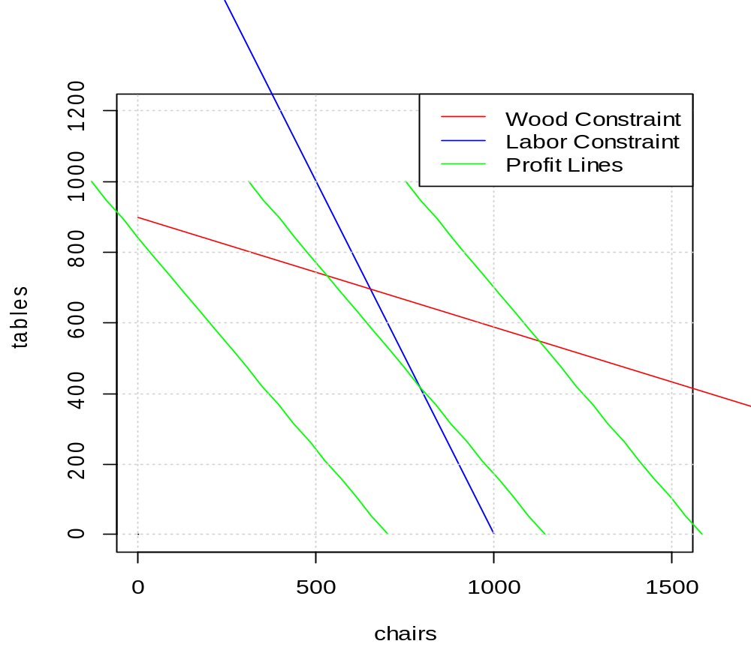
Graphical representation
Profit=8400
Profit=19000

Slide 6
Answer: find the highest profit
Greatest profit: highest profit that is in the feasibility region
Feasibility region: points on the ‘chairs-tables’ space that can be produced: that is there is sufficient labor and wood to produce the combination
In the following graph ‘X’ cannot be produced ‘O’ can.

Slide 7
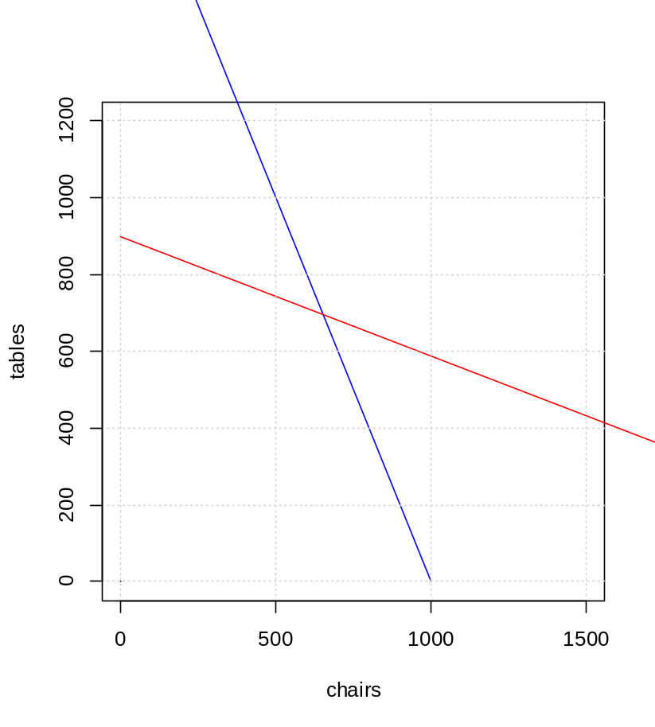
Feasibility region
Any combination of chairs, tables below BOTH lines can be produced; the region with the ‘O’
Any combination not in this region cannot be produced: i.e. insufficient labor or wood, of as with ‘X’ both
X
O

Slide 8
OK I get the idea… how do I find the optimum?
We use an R function,
# Equations:
# Profit=12*T + 10*c
# Wood: 10*T + 3*C < 9000
# Labor: T + 2*C < 2000
# solve our Tables and Chairs:
f.obj = c(12, 10)
f.con = matrix(c(1, 2, 10, 3), nrow=2, byrow=TRUE)
f.dir = c( "<=", "<=")
f.rhs = c(2000, 9000)

Slide 9
And the solution
TCsolution = lp (direction = "max", f.obj, f.con, f.dir, f.rhs)
  print(TCsolution$solution) : 706 T, 647 C
  print(TCsolution) profit = $14, 940
How about when C = 4*T ?
  Then 209 T, 836 C
  Profit = $12,140

Slide 10
Homework:
1. Find values for x and y that
  Maximize 6x + 5y, subject to
  x + y ≤ 5
  3x + 2y ≤ 12
2. Find values for x and y that
  Minimize 4x + y, subject to
  3x+y ≥ 10
  x + y ≥ 5
  x ≥ 3

